Slide 1
Welcome to Tunstall Nursery School 2021-2022

Slide 2
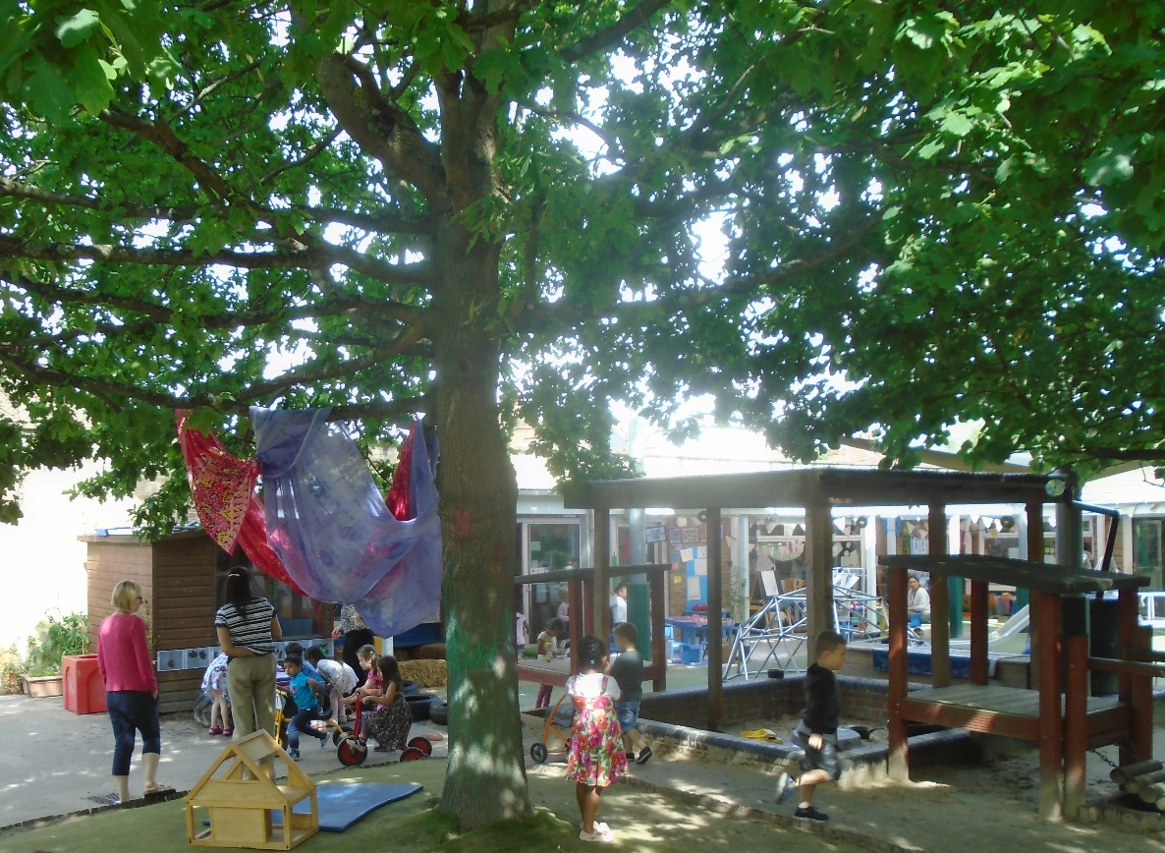
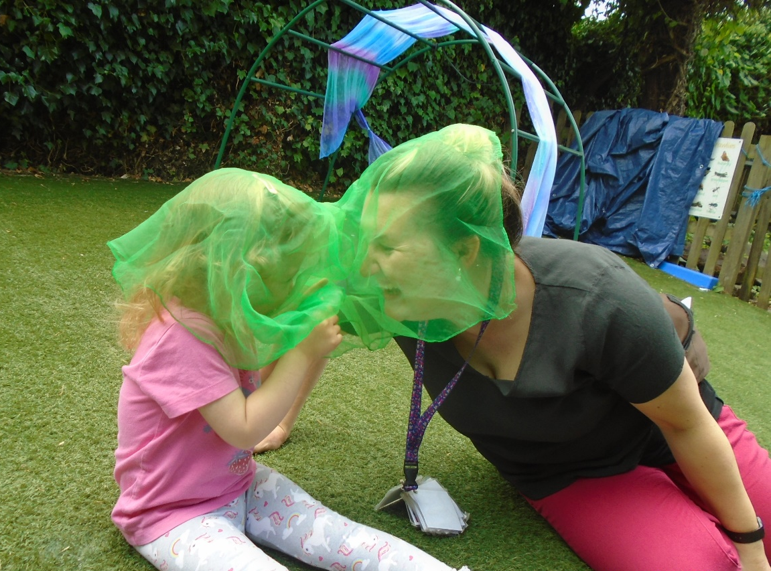
We are looking forward to getting
to know to know you and your child.

Slide 3
Home Visits
We believe that our first encounter with parents and children is crucial in helping to form a positive partnership between home and nursery. Before coming to nursery, parents/carers are their child’s first teacher. Parents/carers have valuable knowledge about their child which will help staff to provide appropriate experiences for them at nursery. Home visits provide a forum for such knowledge to be shared in an informal way. This year home visits will take place by telephone call.
Home visits are an opportunity to:-
Speak to you and your child
exchange information
ensure completion of relevant admission documents
begin to build up a relationship with your child and you
Each telephone home visit should last approximately 20 minutes – your child’s keyworker will contact you to arrange a home visit

Slide 4
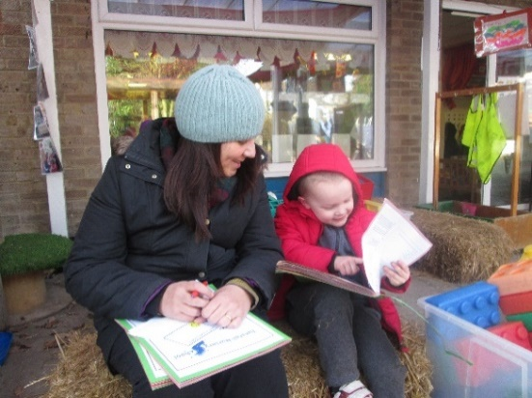
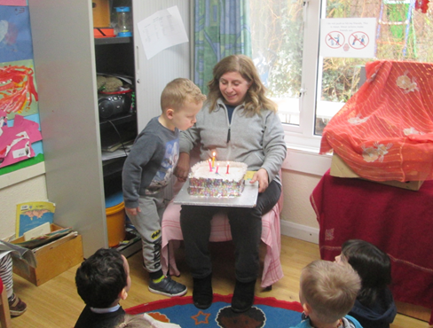
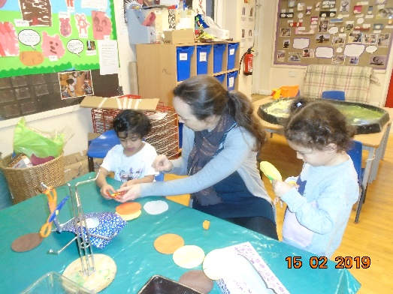
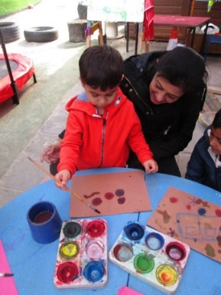
Role of the Keyworker
Each child will be allocated a keyworker.
Your child’s keyworker will support your child throughout their time at nursery.
They will:-
ensure that every child’s care and learning is tailored to meet their individual needs.
help your child become familiar with the setting and to help ensure their safety.
work with parents/carers to support their children’s development at home.
monitor your child’s development and record key moments in their learning journey.
help your children become more independent.
contribute to a quality learning environment.
All staff are very experienced. Please talk to us about any concerns you may have.

Slide 5
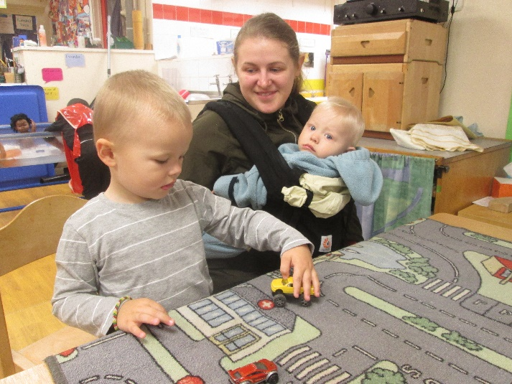
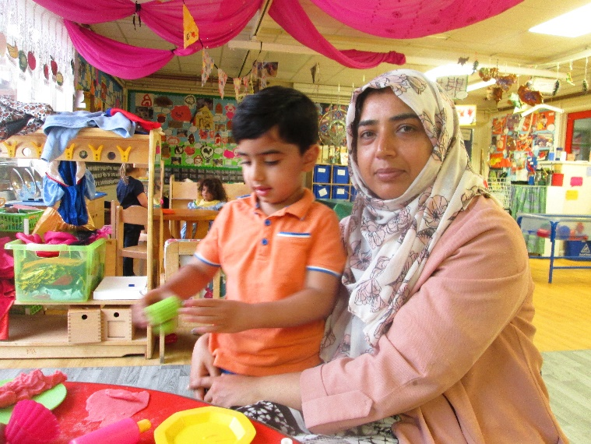
Settling in
Settling your child this year will be different to previous years.
Your child’s keyworker will work with you to support your child to be at nursery independently. Your child will begin with a shortened session. We will work together to gradually increase the time your child spends at nursery.
Please be available to collect your child at anytime during the session, if it is required ,for at least their first week.

Slide 6
Health and Safety
As we are currently still undertaking social distancing, it is unlikely that parents will be entering the nursery on a regular basis. If you do enter the nursery please observe the following -
Mobile phones are not permitted in the nursery
Cameras and taking photographs are not allowed
Ensure doors are always closed behind you; this will prevent other children exiting the nursery room
Health and safety for children -
Children should wear appropriate clothing and footwear so they can run, climb and play easily.
Children must not wear jewellery or scarves – these are not safe.
If your child is unwell, please inform the nursery.
If your child develops vomiting or diarrhoea, they should be not return to nursery for 48 hours.
If your child develops COVID 19 symptoms you must inform us and follow the current government guidance.
The nursery is a nut free zone for the health and safety of those with a nut allergy.

Slide 7
Safeguarding
Please read the safeguarding leaflet.
Please do not accompany a child other than your own into the toilet area.
Please let us know if someone different is coming to collect your child.
If we have any concerns about a child’s wellbeing we have a duty of care to report this to social care.

Slide 8
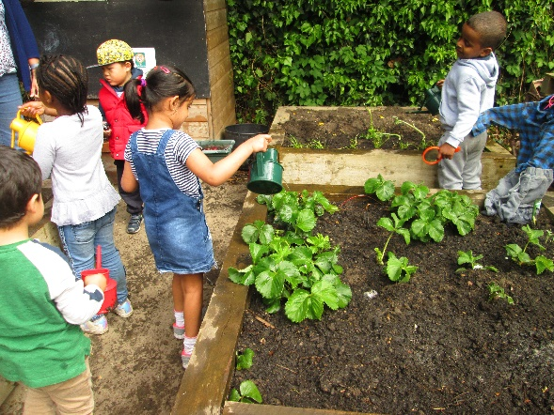
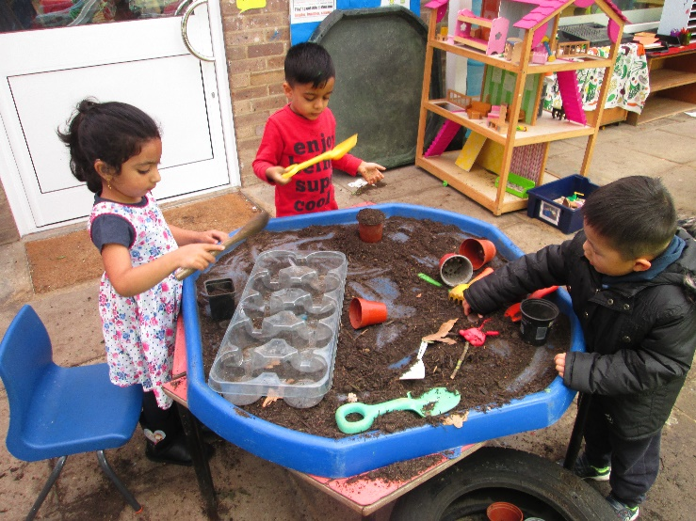
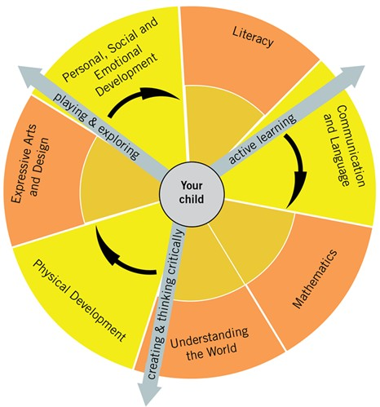
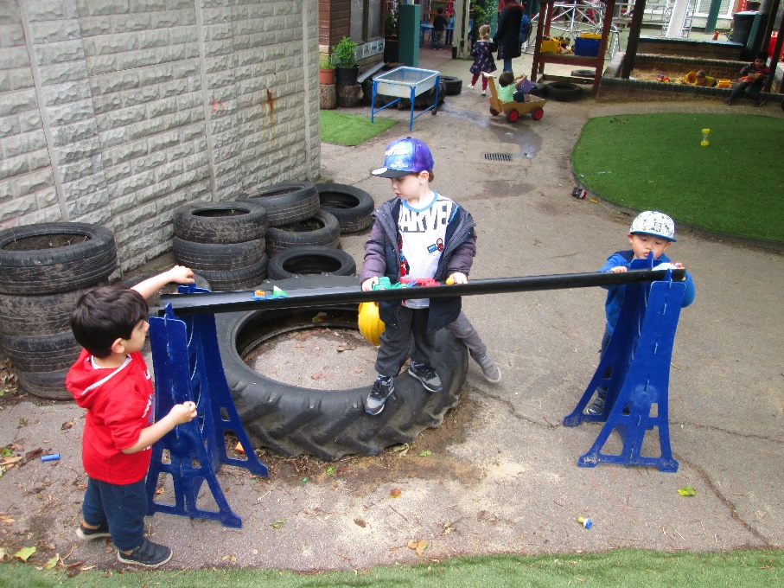
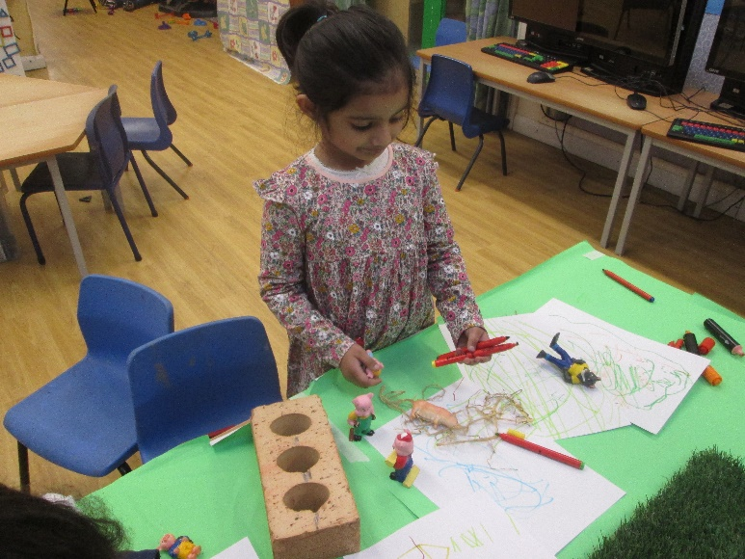
Curriculum
Preparing for nursery
Learning within the setting
Areas of the curriculum

Slide 9
Preparing for nursery

Slide 10
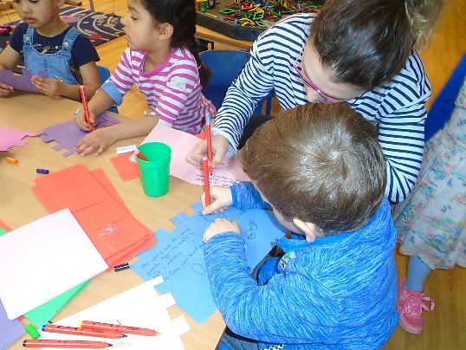
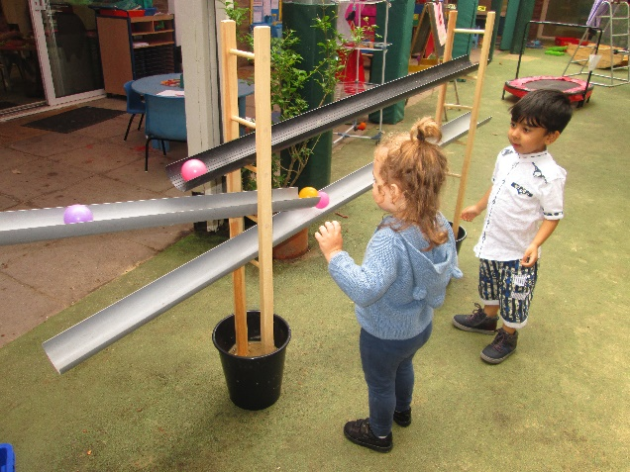
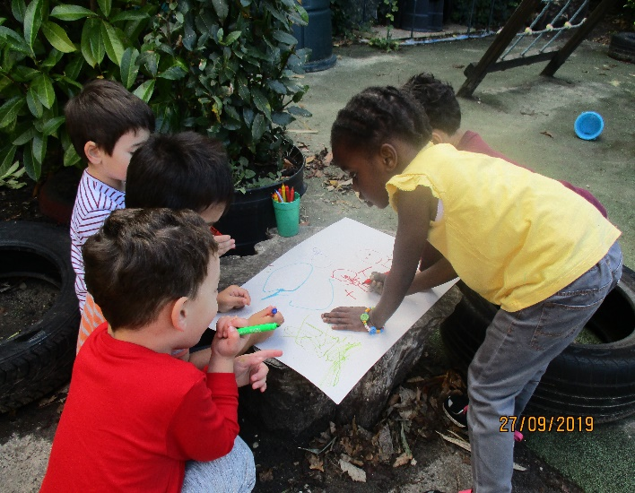
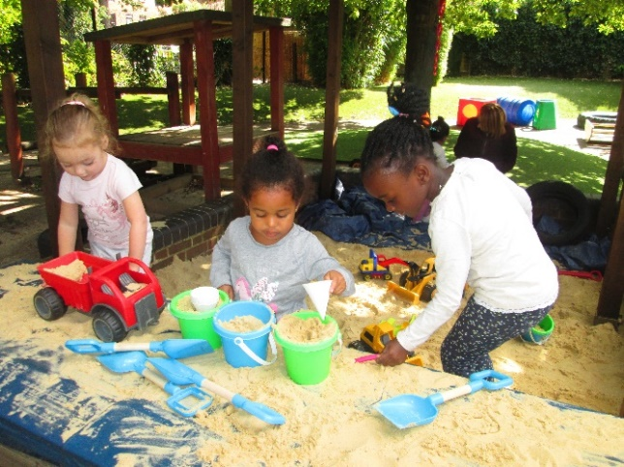
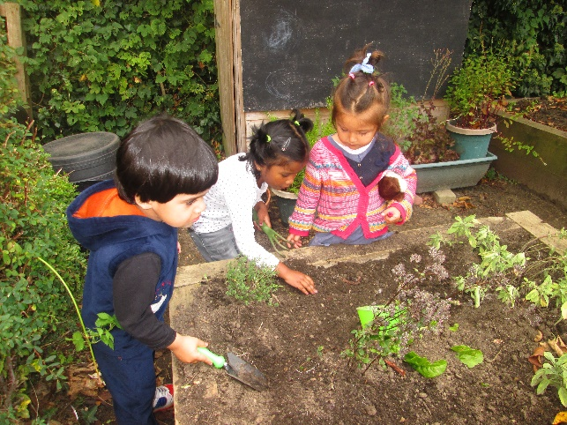
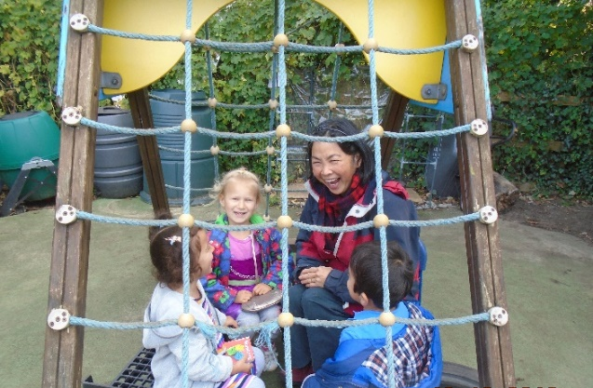
Curriculum
Your child will follow the Early Years Foundation Stage Curriculum (EYFS )
which is a national and play based curriculum.
There are 4 prime areas of learning-
Personal social and emotional development
Communication and language
Physical development
These are supported by 4 specific areas of learning
Literacy,
Mathematics
Understanding of the world
Expressive arts and design

Slide 11
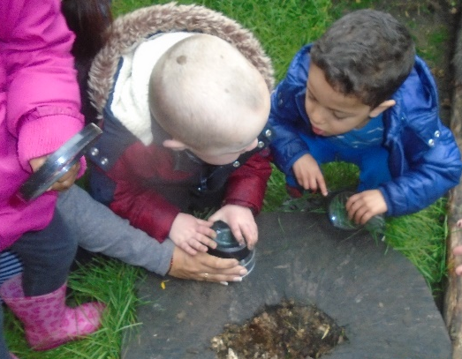
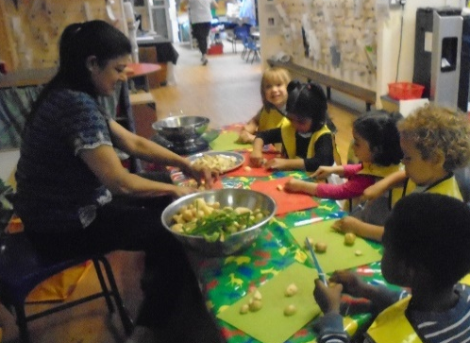
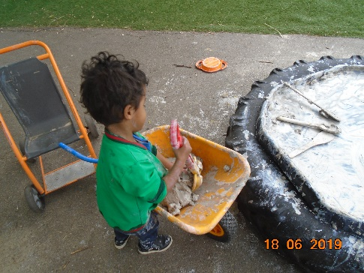
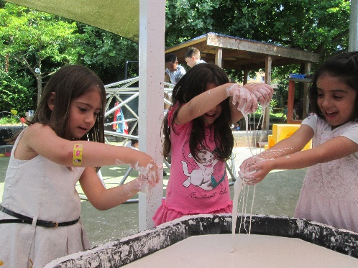
Cognitive skills- the way children learn
Play is children’s work, it is fundamental to how they learn. Through play we support children’s learning and help children to gain new skills and knowledge.
Your child will be:-.
Playing and exploring- finding out and exploring, and being willing to ‘have a go’.
Active learning- being involved and concentrating, keeping trying and enjoying what they set out to do.
Creating and thinking critically-having their own ideas, making links and choosing different ways to do things.
Learning outside is very important for children. A child’s physical development is very closely linked to their brain development. Children learn about the world around them and participate in physical challenges.

Slide 12
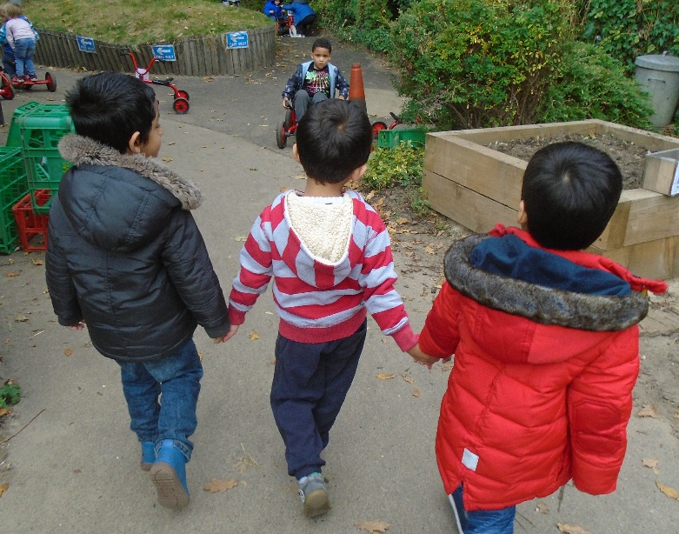
Social and emotional skills
At Tunstall your child will be:-
Enjoying new experiences
Working and playing on their own or with others.
Listening, communicating and sharing experiences with different people.
Gaining a sense of self esteem and self confidence with an awareness and respect for the needs others.
Learning to share and take turns
Gaining the attitudes, skills and knowledge they will need throughout their lives in order, to achieve their own potential and make a full contribution to society.

Slide 13
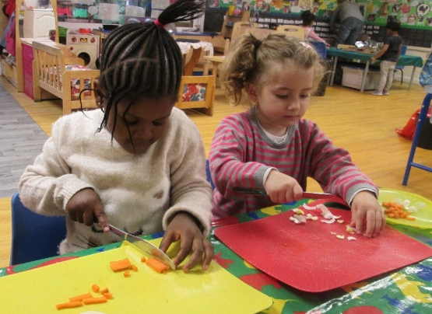
Snacks
Your child will be offered a piece of fruit and milk during the session. We ask for a contribution towards the cost of this.
Lunch club runs from 11.30 -12.30 daily. There is a charge of £6.50 per day for this service.
Your child will need to bring a healthy packed lunch with them.
There are a limited number of places for this service. If you are accessing 30 hours of child care, you will need to use lunch club to keep your child in the setting over lunch time.

Slide 14
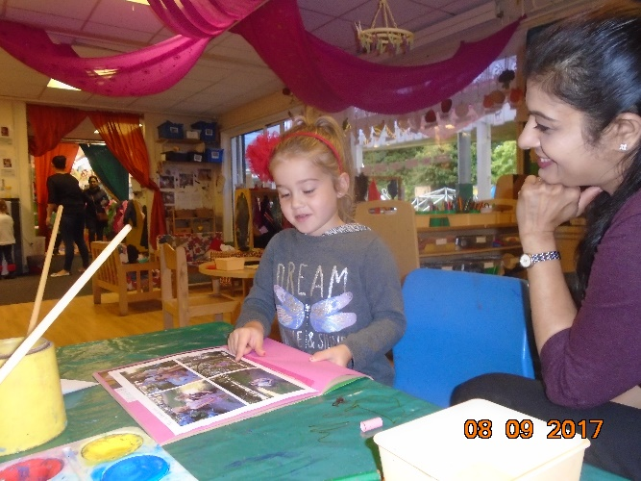
Your child’s Learning Journey
At Tunstall each child has a Learning Journey. This is a record of your child’s work and learning during their time at Tunstall. They are a collection of photos, observations and ‘work’ produced by your child evidencing their progress and development.
Children share their Learning Journey regularly talking about, and reflecting on their ‘work’.
Your child’s keyworker will ask you to contribute to your child’s Learning Journey. Please add photographs of family and friends, significant events in your child’s life using WOW moment stickers and children’s comments and drawings.
Please note GDPR consent forms need to be completed for us to take photographs of your child – Please sign these

Slide 15
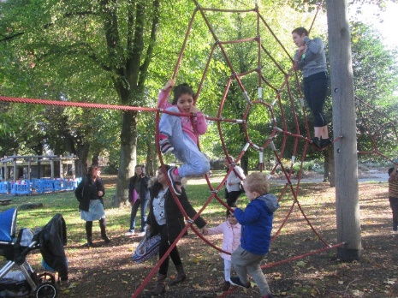
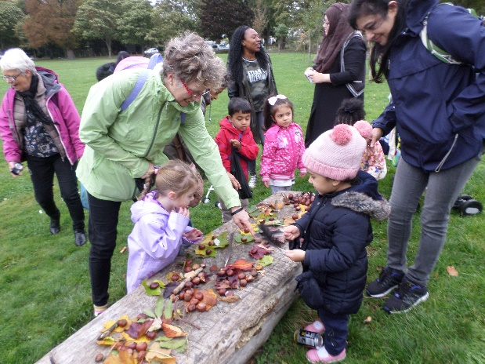
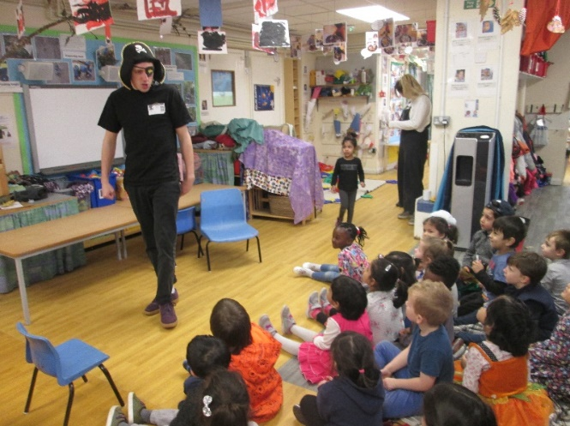
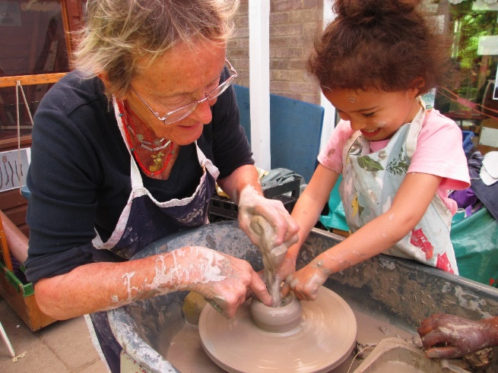
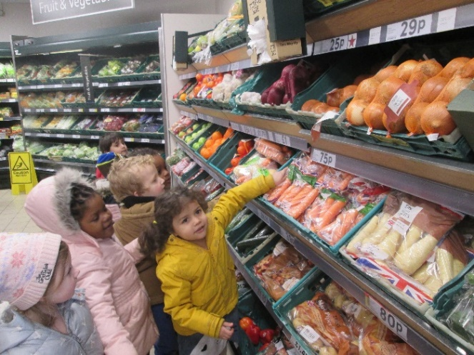
Visits
Visits are a valuable addition to your child’s learning. At Tunstall, we plan to take the children on a variety of local trips such as, to the park, the supermarket, post office . We rely on parents to support us during visits, enabling us to take all of the children. They are a fun way to meet your child’s new friends and other parents. We also have many visitors to the setting, enhancing children’s learning experiences.

Slide 16
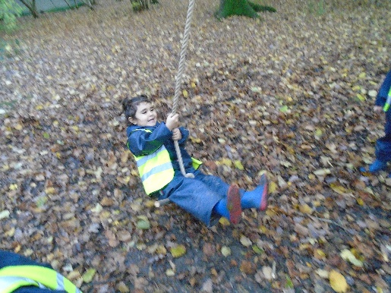
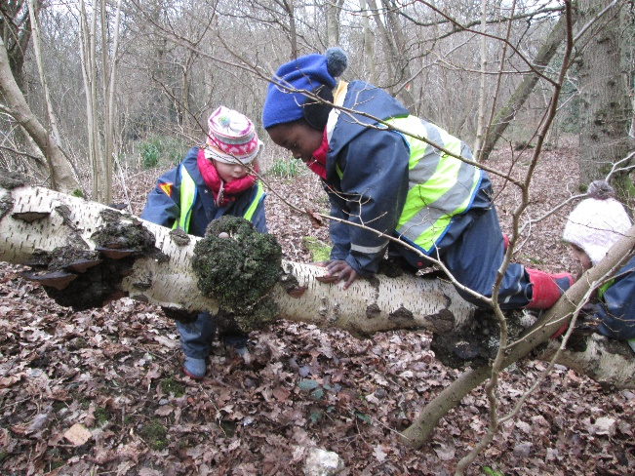
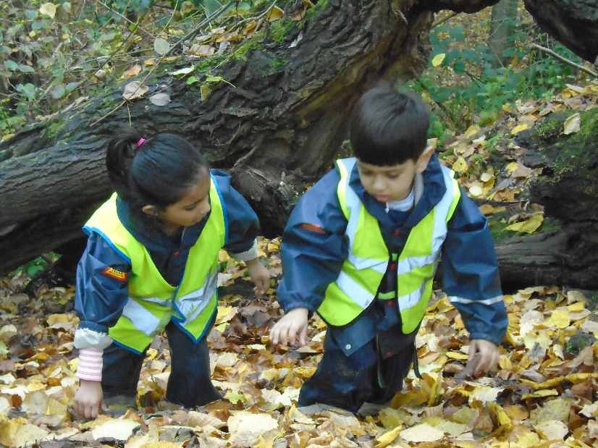
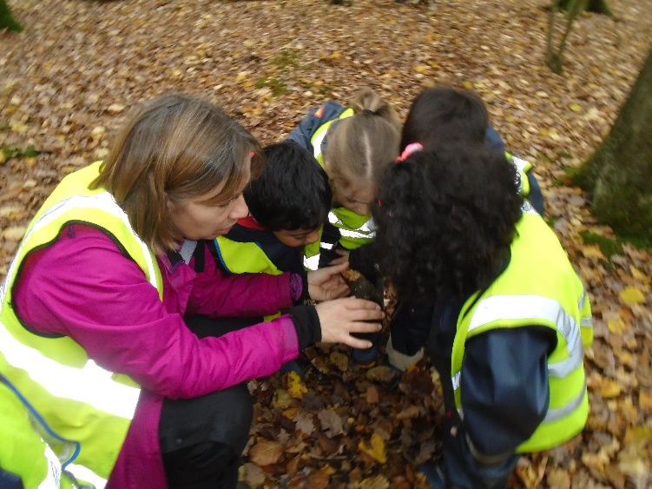
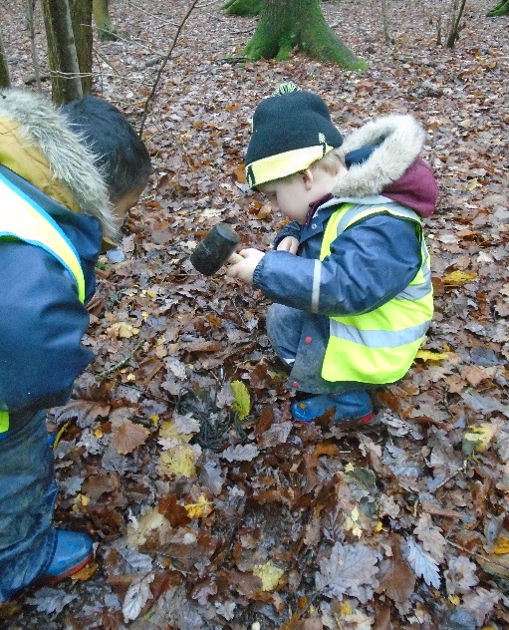
Forest School
Your child will have the opportunity to attend Forest School
Forest School takes place in local woodland.
Forest School is run by qualified Forest School practitioners who continuously maintain and develop their professional practice.
Forest school supports development of self esteem, confidence, independence, collaborative working and creativity.
The children travel by minibus, accompanied by members of staff, to Fryland’s Wood.

Slide 17
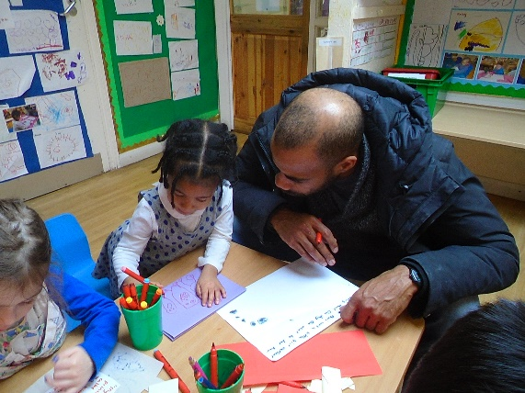
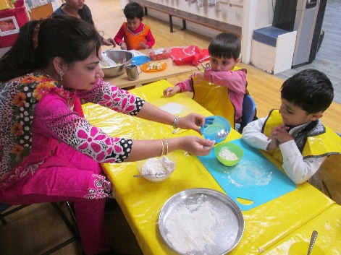
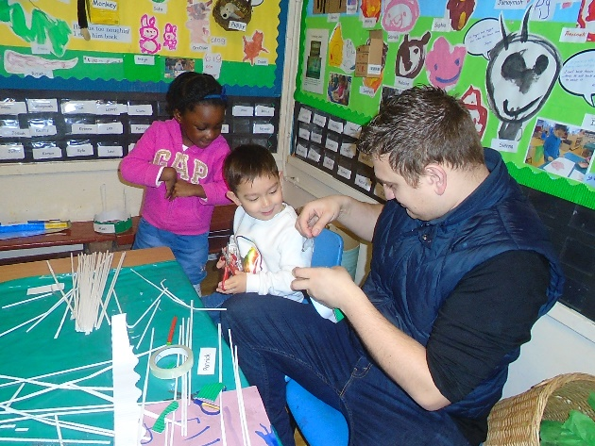
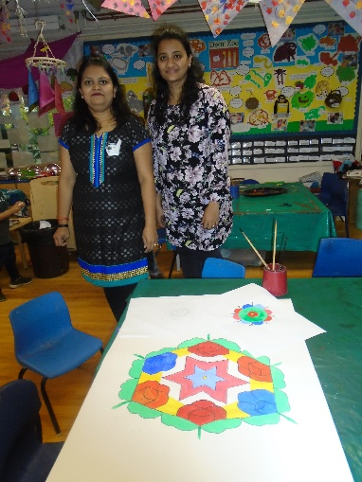
Working with Parents
Here are some ways you can help.
Support your child’s keyworker when settling your child
Contribute towards your child’s Learning Journey
Keep an open dialogue- please speak to us about any concerns
Special Educational Needs – please let us know if you have any concerns about your child’s development so that we can work together for the best interests of your child
If you have any skills you would like to share, cooking, dancing, gardening, playing a musical instrument or fixing things, please let us know.
Volunteer to help with the sharing library.

Slide 18
Toileting
You should start training your child when you feel they are ready . Most children are ready between 22 and 30 months of age.
Try to toilet train your child before they start nursery if they are joining the three / four year old room
Toilet training is an important part of your child’s development. It is an important skill, allowing them to be independent and develop their self-care skills.
Remember your child will have accidents. Try not to show your disappointment, remain calm and quietly clean up the area and your child. It is important that your child does not feel ashamed.
Children have accidents at nursery, this is ok. Staff are used to supporting and helping children.
If your child is developmentally delayed or has Special Educational Needs or Disabilities it may not be the right time to toilet train. The nursery does have nappy changing facilities and staff are able to change nappies.
Please speak to your child’s keyworker if you have any concerns.

Slide 19
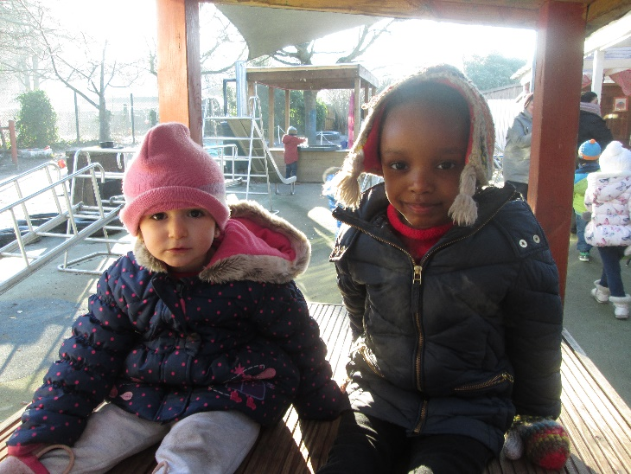
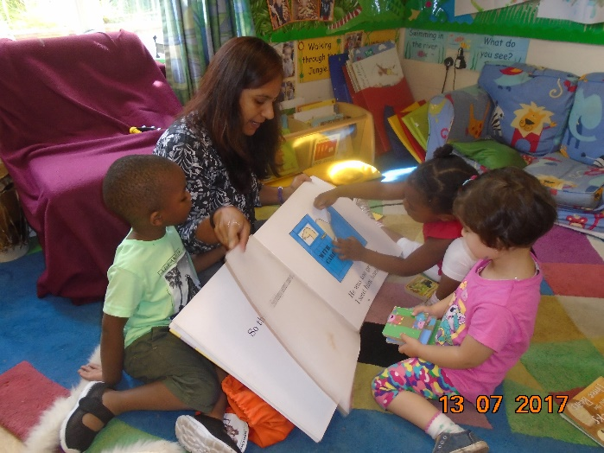
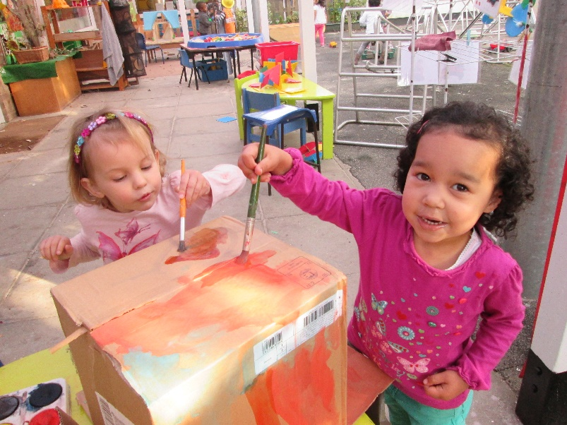
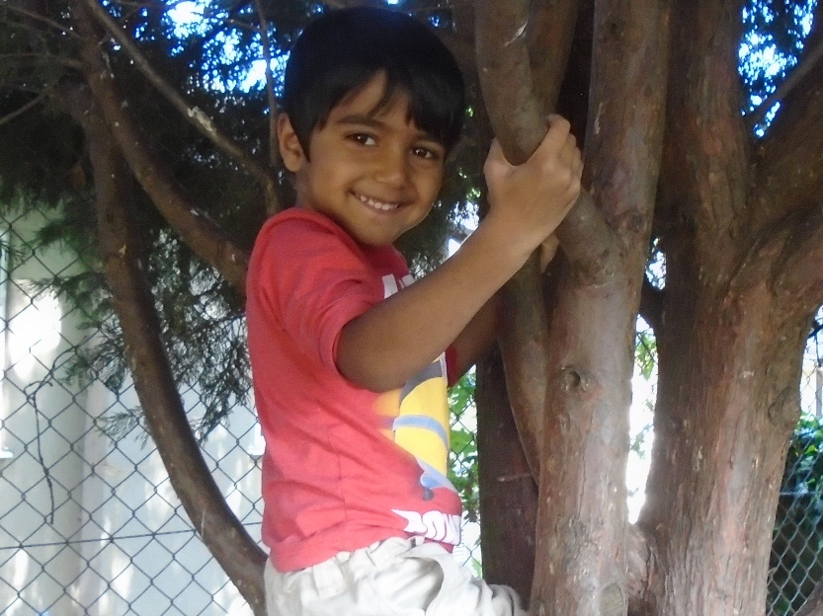
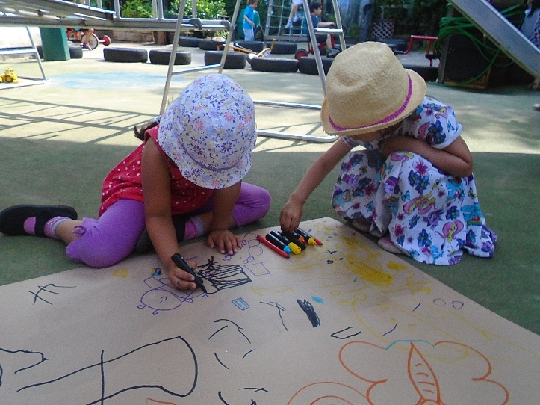
We look forward to welcoming you in
September

